Slide 1
Time Series Predictions on Real Estate prices
Examining average real estate prices
per zipcode in
Chicago, IL

Slide 2
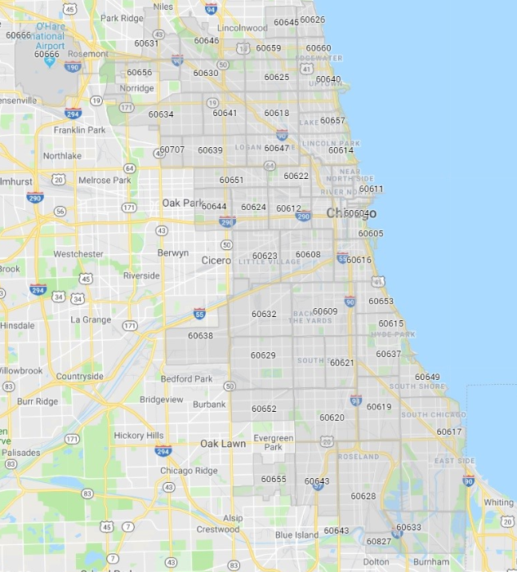
Zipcodes in Chicago

Slide 3
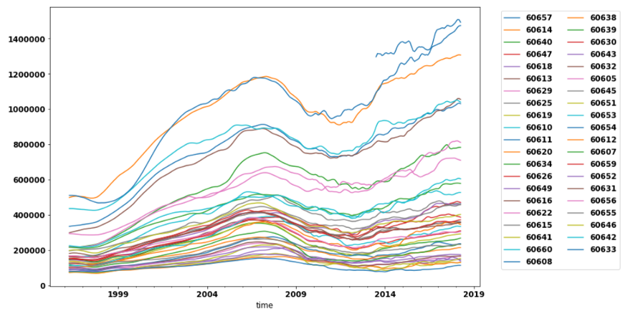
General Trends

Slide 4
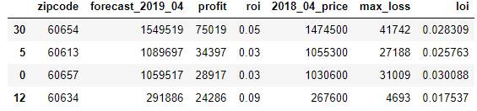
Results
Top zipcodes based on Profit and Return on Investment

Slide 5
Recommendations
Due to risk of loss and the small profit margins: I do not recommend to invest in Real Estate in Chicago, IL

Slide 6
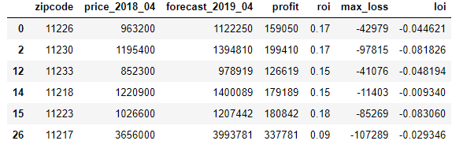
Future work
Find another area to invest in, such as Kings County, NY:
Best zipcodes based on Profit and Return on Investment

Slide 7
Thank you for joining me for this presentation. Levi Raichik

